Slide 1
Brainer – Sales Forecasting
August 2018

Slide 2
Agenda
Executive Summary
Problem Breakdown
EDA & Insights
Results & Recommendations
Appendix

Slide 3




Executive Summary
EDA
Sales and Promotion data was provided and the level of data was date and month respectively
Understanding the relationship between the sales of different drugs
Increase in the sales of a drug is sharper than the decrease in the sales
Hypothesis Testing
Single promotion has more effect on sales of the drugs rather than a group of promotions
Sales of a drug set is more impacted by a particular promotion
Different drugs in a drug set have similar trend in sales
Modelling
Forecasted Sales, in 2018, had peaks in the months that had appropriate promotions.
Recommendations
Using single promotion can have a higher impact on the sales rather than a group of promotions
Applying the promotion pertaining to a particular drug set will increase the sales
Focusing on promotions, with room for improvement, will positively affect the sales

Slide 4
Agenda
Executive Summary
Problem Breakdown
EDA & Insights
Results & Recommendations
Appendix

Slide 5
What is the problem and how to solve it?
Problem definition
EDA
Hypothesis Testing
Modelling
Brainer’s Operations team wants to identify the factors affecting the sales
Based on the key factors, Brainer wants to predict the drugs’ sales for the upcoming years
During data analysis we checked for
Basic information about the relationship between drugs’ sales
Seasonality in sale of the drugs
Trend in sale of the drugs
Abnormal sales peaks (outliers) in particular months
Single promotion, for a particular drug set, is more effective than a group of promotions
A particular promotion is more effective for a particular drug set
Drugs of the same drug set follow a similar trend in sales
Build a forecasting model to predict sales for next year (2018) based on promotions

Slide 6
Agenda
Executive Summary
Problem Breakdown
EDA & Insights
Results & Recommendations
Appendix

Slide 7
The data provided includes the sales of 16 drugs and the use of 11 promotions
Daily Drug Sales Data
Four different datasets
Data range is between January 1st, 2011 and December 31st, 2017
Data Cleaning
Performed missing value analysis to ensure the data was clean
Data Aggregation
Changed the level of data from date level to month level and aggregated the sales data and promo data
01
02
03
04
05
Monthly Promotion Data
11 unique promotions in one dataset
Data range is between January 2011 and December 2018
Data Trimming
Trimmed the 2018 promotion data from the promotion dataset

Slide 8
Based on the sales trend, drugs are grouped into 4 drug sets

Slide 9
Promotions and Seasonality impact the correlated drugs
Drug Analysis
Promotion Analysis
Top 3 performing drugs contribute 38% to the total sales and bottom 3 drugs contribute 2.5% to the total sales
Single promotion has higher impact on the sales of the drugs rather than a group of promotions
When a particular promotion is applied on a specific drug set, sales of that drug set increases
Drug Set Behavior
Seasonality
Drugs’ sales of a particular drug set is not significantly affected by changes in sales of drugs in other drug set
Seasonality exists in the sales of the drugs as the second quarter experiences most sales

Slide 10
Upon further exploration, it is found 4 out of 11 promotions significantly affect sales of particular drug sets
Promo 10
Afirudin
Promo 7
Cortimentin
Promo 1
Verarotec
Promo 4
Tetapril
Pentranil
Oxozone
Halocadren
Adapazide
Novastral
Nalopex
Divinesin
Lansoprofen
Fentaprine
Trantalol
Multilinum
Formoprodol
Set 1
Set 2
Set 3
Set 4

Slide 11
Agenda
Executive Summary
Problem Breakdown
EDA & Insights
Results & Recommendations
Appendix

Slide 12
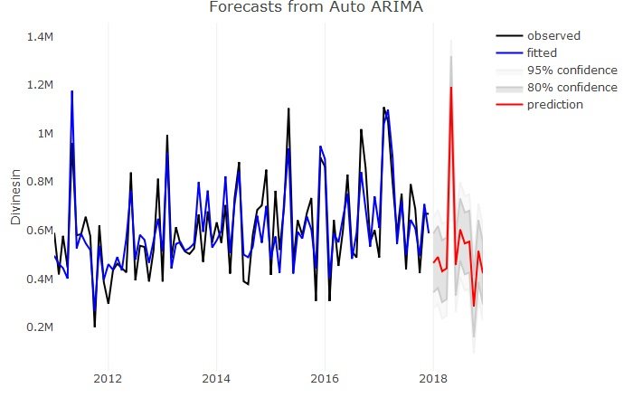
Using ARIMA model, forecasted sales of Divinesin is achieved with 84% accuracy in 2018 where promotion 1 is applied
Note:
After grouping the drugs into different drug sets, the forecasting model was applied only on one drug from each drug set
This is done because all the drugs in a drug set have similar trend in sales
The forecasted peak happened in the month in which the appropriate promotion was applied

Slide 13
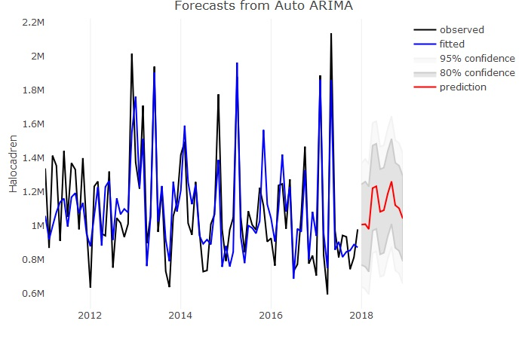
Using ARIMA model, forecasted sales of Halocadren is achieved with 84% accuracy in 2018 where promotion 4 is applied
Note:
Note:
After grouping the drugs into different drug sets, the forecasting model was applied only on one drug from each drug set
This is done because all the drugs in a drug set have similar trend in sales
The forecasted peak happened in the month in which the appropriate promotion was applied
After grouping the drugs into different drug sets, the forecasting model was applied only on one drug from each drug set
This is done because all the drugs in a drug set have similar trend in sales
The forecasted peak happened in the month in which the appropriate promotion was applied

Slide 14
What can be improved?
Brainer’s Operations team should focus on the promotions pertaining to a particular drug set
Using single promotion can have higher impact on the drugs’ sales rather than group of promotions
More focus should be given on the promotions which have room for improvement
Applying the right promotions to drug sets 1 & 2 will give an increase sales

Slide 15
Agenda
Executive Summary
Problem Breakdown
EDA & Insights
Results & Recommendations
Appendix

Slide 16
APPENDIX

Slide 17
Deliverables
Account Structure -
Client Context -
Vertical Write-up -
Empathy Map -
EDA brick -
Dashboard -
Hypothesis testing -
Forecasting -

Slide 18

SGQ
Gap
Need to identify the factors that influence the drugs’ sales
Current State
Desired Future State
The Operations team of Brainer monitors the performance of sales of drugs and their market share
The team currently forecast sales based on individuals’ experience and historic trends which give an approximation of the sales
The team wants to identify the factors influencing the sales of the drugs using a data driven approach
Outcome: The Brainer’s Operations team has increased the market penetration of the drugs further increasing its’ sales Behavior: Operations team has incorporated the forecasting technique to understand the drugs’ sales Insight: The team has identified important factors which influence sales using the comprehensive sales forecasting model
Questions – which need answers
What are the key drivers that impact the drugs’ demand and its’ market size?

Slide 19
Hypothesis testing
Paired sample sign test
Single promotion has higher impact on the sales of the drugs rather than a group of promotions
Multiple Regression analysis
When a particular promotion is applied on a specific drug set, sales of that drug set increases
Time series analysis
Sales of the drugs in a particular drug set follow a similar trend

Slide 20
THANK YOU

